Slide 1
Retrieval-based Grounding for LLMs
Maya Rao, Aidan Delwiche, Chris Kok

Slide 2
Retrieval Augmented Language Model Pre-Training
Notes:
https://proceedings.mlr.press/v119/guu20a.html

Slide 3
Background
Language Model Pre-training
Masked Language Model (MLM)
Predicting missing tokens requires syntactic, semantic, and world knowledge.
Scalability issue
Lack of Modularity and Interpretability
Open-domain Question Answering (Open-QA)
Example: “What is the currency of the UK?” → “pound”
requires access to and comprehension of broad information from external sources.
“open” = the model does not receive a pre-identified document that is known to contain the answer
Notes:
Background on Language Model Pre-training and Its Limitations
- Masked Language Model (MLM) training principle explained.
- Predicting missing tokens requires syntactic, semantic, and world knowledge.
- Scalability issue: Larger networks needed for more knowledge, which is costly.
- Existing solutions lack:
- Modularity in knowledge storage.
- Interpretability of retrieved knowledge.
Introduction to Open-domain Question Answering (Open-QA)
- Evaluating models' world knowledge through Open-QA.
- Open-QA requires access to and comprehension of broad information from external sources.
- REALM's approach extends retrieval-based Open-QA methods to pre-training, aiming for both performance and interpretability.
Related Work and REALM's Novel Contributions
- Contrast with existing retrieval-augmented and generation-based Open-QA systems.
- REALM's unique contribution: Unsupervised pre-training with a latent knowledge retriever, improving both efficiency and interpretability.
- State-of-the-art performance on Open-QA benchmarks, showcasing the effectiveness of retrieval-augmented pre-training.

Slide 4
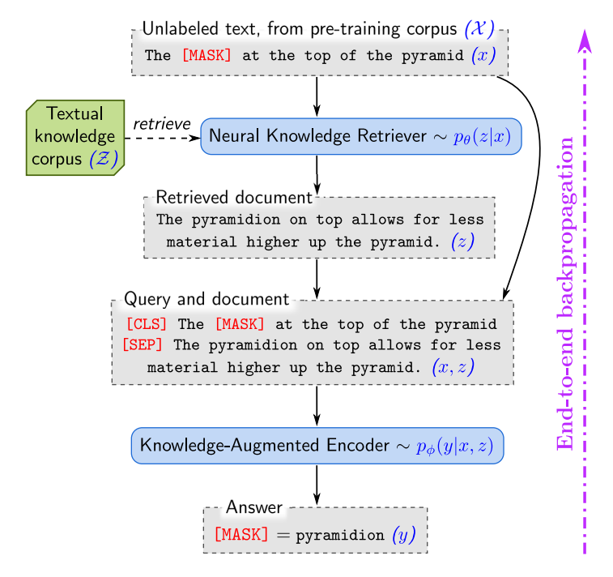
Overview
Two-step process: Retrieve then predict
Training & fine-tuning both the retriever and the encoder
4-16% increase in accuracy
Notes:
REALM Framework Overview
- Figure 1 visualization: Incorporating a neural knowledge retriever into language model pre-training.
- Two-step process: Retrieve relevant documents, then predict missing information.
- Training based on unsupervised text with masks, using retrieval quality as a learning signal.
- Leverages Maximum Inner Product Search (MIPS) for efficient document selection from large corpora.
Challenges:
- Requires backpropagation through a retrieval step considering millions of documents.
- Significant computational demands addressed through innovative retrieval structuring.

Slide 5
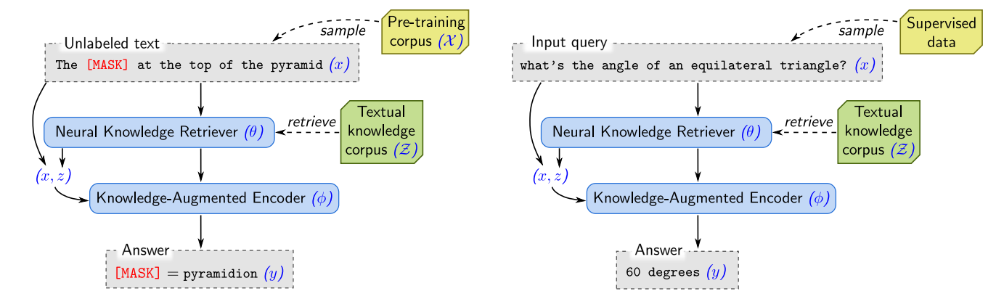
Model Architecture
Unsupervised pre-training
Supervised fine-tuning
Notes:
REALM's Retrieve-then-Predict Generative Process
- Overview: REALM operates on a two-step generative process: retrieve relevant documents, then predict the missing information.
- Pre-training Task: Input sentences with masked tokens aim to predict these missing tokens (Masked Language Modeling).
- Fine-tuning Task: Input questions aim to predict answers (Open-domain Question Answering).
- Modeling Approach:
- Treats document retrieval as a sample from p(z|x) and the prediction given the input and retrieved documents as p(y|z,x).
- Marginalizes over all documents to compute the final prediction likelihood p(y|x).
REALM's Core Components and Model Architecture
- Neural Knowledge Retriever:
- Uses dense inner product to compute relevance scores between input and documents.
- Embeddings for input and documents created via BERT-style Transformers.
- Knowledge-Augmented Encoder:
- Defines p(y|z,x) by taking input and retrieved document, passes through Transformer for prediction.
- Uses a separate Transformer from the retriever for rich cross-attention.
- Unique Training Challenges:
- Manages computational load by focusing on top k documents.
- Utilizes Maximum Inner Product Search (MIPS) for efficient top k retrieval.
- Employs asynchronous updates to keep the retriever's MIPS index fresh.
Training REALM and Overcoming Computational Hurdles
- Training Objective: Maximize the log-likelihood of the correct output by optimizing model parameters using stochastic gradient descent.

Slide 6
Inductive biases
Salient span masking
BERT-based tagger trained on CoNLL-2003 data
Requiring world knowledge → mask salient spans such as “United Kingdom” or “July 1969”
Null document
Prohibiting trivial retrievals
Initialization
Inverse Cloze Task (ICT)
Notes:
- Inductive Biases and Pre-training Enhancements:
- Focuses on salient spans requiring world knowledge.
- Incorporates a null document option for instances where retrieval is unnecessary.
- Prevents trivial retrievals where input and document are the same, encouraging diverse knowledge incorporation.
- Initialization Strategies to Avoid Cold Starts:
- Begins with pretrained embeddings to ensure relevant retrievals from the start.
- Knowledge-augmented encoder warmed-up using BERT pre-training.

Slide 7
Experiments
NaturalQuestions-Open (NQ)
naturally occurring Google queries and their answers.
WebQuestions (WQ)
Google Suggest API, using one seed question and expanding the set to related questions.
CuratedTrec (CT)
collection of question-answer pairs drawn from real user queries issued on sites such as MSNSearch and AskJeeves.

Slide 8
Approaches
Retrieval-based Open-QA
Step 1: retrieve relevant documents from a knowledge corpus
Step 2: use reading comprehension system to extract an answer
Generation-based Open-QA
Step 1: encode the question
Step 2: decode the answer token-by-token based on the encoding

Slide 9
Implementation
Pre-training
200k steps on 64 Google Cloud TPUs, with a batch size of 512 and a learning rate of 3e-5, using BERT’s default optimizer.
Two choices of the pre-training corpus X : (1) Wikipedia, which is identical to the knowledge corpus Z, and (2) CC-News, reproduction of the corpus of English news proposed by Liu et al. (2019).
Fine-tuning
Following the ORQA (Lee et al., 2019) finetuning approach but initialized with the pre-trained REALM components.
The knowledge corpus is derived from the December 20, 2018 snapshot of English Wikipedia.
Documents are greedily split into chunks of up to 288 BERT wordpieces

Slide 10
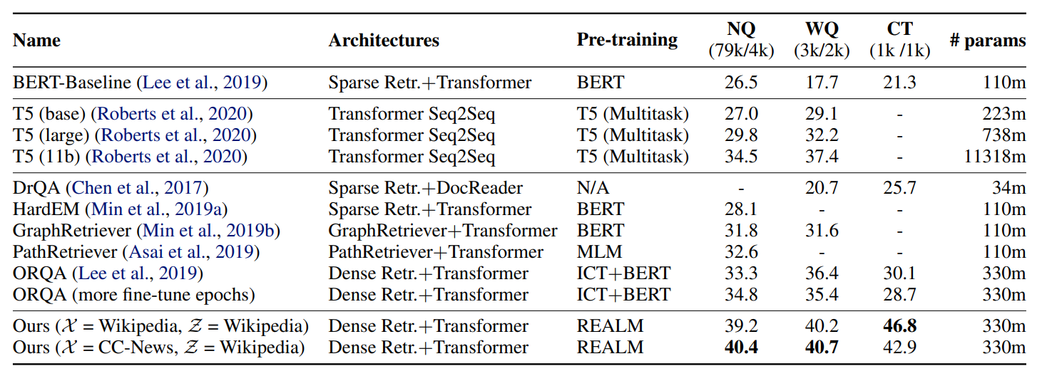
Results
Notes:
Evaluating REALM on Open-QA Benchmarks
- Open-QA Benchmarks Utilized:
- NaturalQuestions-Open: Google queries with short, answerable questions.
- WebQuestions: Expands from Google Suggest API with related queries.
- CuratedTrec: Real user queries with answers as regular expressions.
- Comparative Approaches:
- Existing systems use retrieval-based (e.g., DrQA, ORQA) and generation-based (e.g., T5) methodologies.
- REALM differentiates with latent variable model for learnable retrieval and unique language model pre-training.
REALM Outperforms Existing Models
- Main Results:
- REALM achieves state-of-the-art results on NaturalQuestions-Open, WebQuestions, and CuratedTrec datasets.
- Outperforms large generative models like T5 despite having significantly fewer parameters.
- Direct comparison with ORQA shows substantial improvements due to REALM's novel pre-training approach.
- Implementation Details:
- Pre-trained on either Wikipedia or CC-News, fine-tuned for Open-QA using a specific Wikipedia snapshot.
- Retrieved and marginalized over 8 candidate documents during pre-training, including a null document for cases not requiring retrieval.
Insights from REALM Experiments and Ablations
- Ablation Experiments:
- Components contributing to success: improvements in both encoder and retriever from REALM pre-training.
- Salient span masking crucial for focusing on knowledge-intensive tasks.
- Frequent MIPS index refreshes during pre-training are vital for maintaining retrieval relevance.
- REALM's Effective Retrieval Example:
- Demonstrates REALM's ability to retrieve contextually relevant documents to accurately predict masked tokens, significantly outperforming models like BERT in knowledge integration.
- Takeaway:
- REALM exhibits strong capabilities in leveraging learned retrieval for enhanced performance in Open-QA tasks, highlighting the importance of its novel pre-training and fine-tuning strategies.

Slide 11
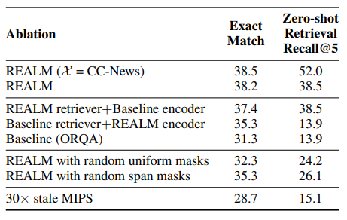
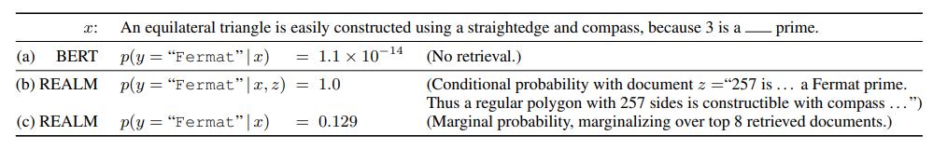
Analysis
Encoder or Retriever
Both = Best!
Masking scheme
MIPS index refresh rate
Every 500 training steps
Notes:
Maximum Inner Product Search (MIPS)
Masking scheme We compare our salient span masking scheme (Section 3.4) with (1) random token masking introduced in BERT (Devlin et al., 2018) and (2) random span masking proposed by SpanBERT (Joshi et al., 2019). While such salient span masking has not been shown to be impactful in previous work with standard BERT training (Joshi et al., 2019), it is crucial for REALM. Intuitively, the latent variable learning relies heavily on the utility of retrieval and is therefore more sensitive to a consistent learning signal.

Slide 12
Discussion
Alternate ways of viewing REALM that connects it to a broader set of ideas beyond Open-QA
Language modeling with corpus as context
REALM goes beyond previous work which focuses only on surrounding words, sentences, and paragraphs, and includes the entire text corpus
Retrieve-and-edit with learned retrieval
REALM extends previous work by making the model itself learn which texts are most useful for reducing perplexity
REALM can depend on information beyond lexical overlap
Notes:
The authors then discussed the different ways REALM connects to bigger ideas beyond just Open-QA
Language modeling with corpus as context
One concept that has started to be explored is language representation models incorporating contexts of increasingly large scope when making predictions
REALM goes beyond previous work which focuses only on surrounding words, sentences, and paragraphs, and includes the entire text corpus
Retrieve-and-edit with learned retrieval
To better explain the variance in the input text and enable controllable generation other work has explored creating a language model with the retrieve-and-edit framework that conditions on text with high lexical overlap
REALM however extends previous work by making the model itself learn which texts are most useful for reducing perplexity
REALM can depend on information beyond lexical overlap

Slide 13
Future Work
REALM is only a minimal instantiation of the concept they are attempting to explore
They believe their work will be generalizable to
Structured knowledge
Multilingual setting
Multi-modal setting
Notes:
REALM itself is only a small early version of what they want to accomplish with this concept
They believe their work will be generalizable to:
Structured knowledge
Create a generalization where we also learn the decision of which entities are informative
Multilingual setting
Retrieving knowledge in a high-resource language to better represent text in a low-resource language
Multi-modal setting
Retrieving images or videos that can provide knowledge rarely observed in text

Slide 14
Improving Language Models by Retrieving from Trillions of Tokens
Notes:
https://proceedings.mlr.press/v162/borgeaud22a.html

Slide 15
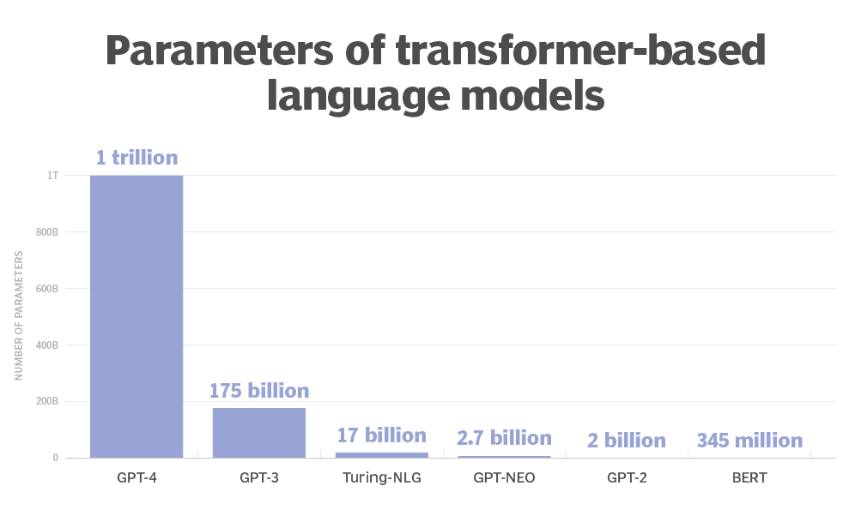
Introduction
Using transformers utilizing attention to contextualize the past has been proven to be a powerful language model
These transformer models have started to be scaled up to use over a hundred billion parameters as increasing model size has improved the performance on downstream tasks
The two main benefits of increasing the amount of parameters are:
Additional computations at training and inference time
Increased memorization of the training data
Notes:
The authors are investigating transformers utilizing attention to contextualize the past as a potential solution to parameter issue with current LLMs since they have been proven to be very powerful
The existing LLMs like BERT and ChaT GPT have seen recent increase in performance by scaling up their systems to use over a hundred billion parameters
It has been proven that by increasing the amount of parameters, there can be both increased computations at training and inference time, and increased memorization of the training data which leads to better performance
As you can see from the image this solution to increasing performance is highly favored
However this increase in parameters comes with some consequences with certain areas like computation cost

Slide 16
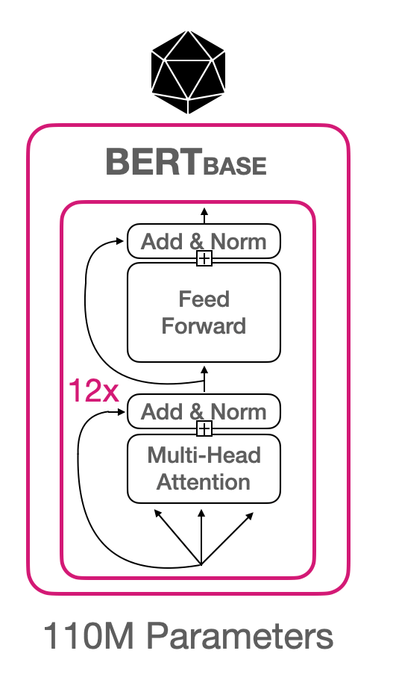
Motivation
They want to look at efficiently augmenting language models with a massive-scale memory without significantly increasing computation
Instead of increasing the model size and training on more data, they propose giving the model access to a large database to help with predictions
They want to prove that in order to improve performance the model does not need to necessarily increase the amount of parameters
Notes:
Thus the author's main goal is to augment language models by using more memory instead of increasing computation
Their main novelty is that they incorporate a database full of documents to help with predictions
Essentially their goal is to prove in general that to improve performance the model does not need to necessarily increase the amount of parameters

Slide 17
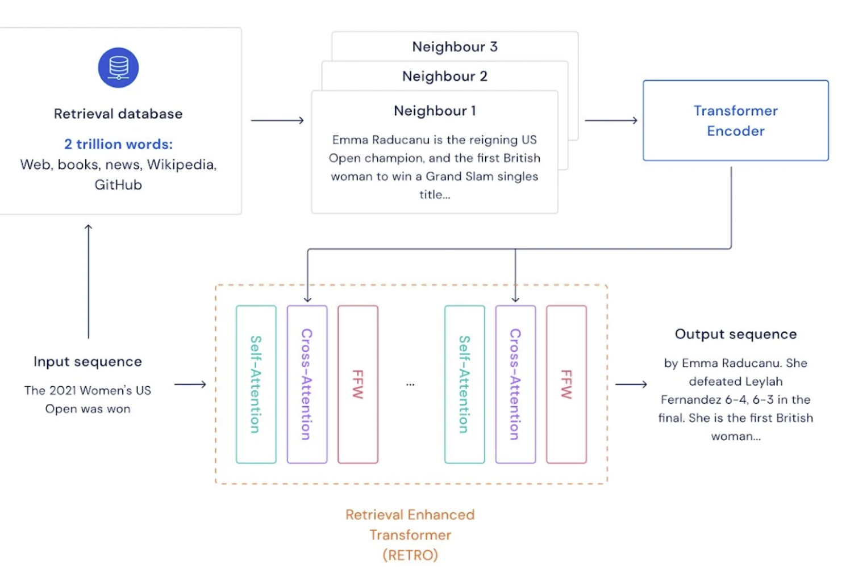
Approach: RETRO
On a high level RETRO
Splits the input sequence into chunks
Retrieves text similar to the previous chunk to improve predictions in the current chunk
Their work is the first to reduce the amount of parameters by using a retrieval database for language models
Notes:
RETRO is the system the designed
On a high level RETRO
Takes in the input sequence
Sends it to the retrieval database, where it selects texts that are the nearest neighbors to the input sequence
They are then encoded and input into the retrieval enhanced transformer which then generates the output sequence
Their work is the first to explore using a retrieval database with language model to reduce the amount of parameters

Slide 18
Contributions
RETRO, a retrieval-enhanced autoregressive language model that uses a chunked cross-attention module to incorporate the retrieved text
Show that retrieving based on a pre-trained frozen BERT model works at scale, so there is no need for training and updating a retriever network
Show their model can be improved at evaluation time by increasing the database size and the number of retrieved neighbors
Propose an evaluation that is aware of text documents with the training set to eliminate the issue of test set leakage
Show RETRO performs well this type of evaluation so it is possible to conclude the model utilizes both explicit neighbor copying and general knowledge extraction
Notes:
The paper focused on five main contributions they made to the field
One- creating RETRO, a retrieval-enhanced autoregressive language model that uses a chunked cross-attention module to incorporate the retrieved text
Two- demonstrating a frozen BERT model can be used at scale, eliminating the need for maintaining a retriever network
Three- instead of increasing parameters, it is possible to improve the models performance by increasing the database size and the number of retrieved neighbors
Four- created a type of evaluation that looks at test set leakage, and showing that RETRO does well on that evaluation

Slide 19
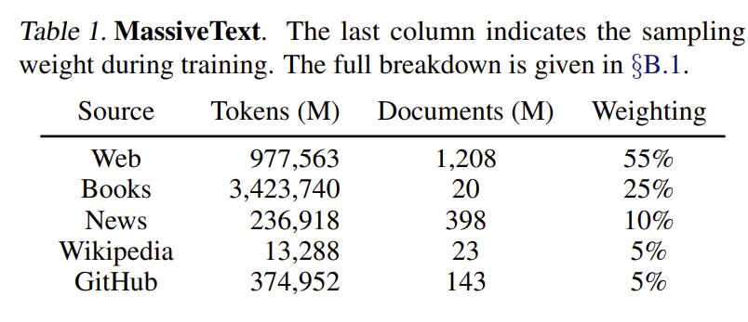
Method: Training Dataset
Used a multilingual version of MassiveText for both training and retrieval data
Sequences are sampled from training data with sampling weights
They tokenized the dataset with SentencePiece, and they use 600B tokens from the dataset for the training data
For the evaluation retrieval database they use all the tokens adding up to 1.75 trillion tokens
Notes:
They used MassiveText as the source of their data, and it is split up into types of web, books, news, Wikipedia, and Github
They created the training dataset by sampling with the weights shown in the chart, so it would favor some types of media more
They tokenized their data with SentencePiece, and there are 600B tokens in the training dataset, and 1.75 trillion tokens in the valuation retrieval database

Slide 20
Method: Retrieval-enhanced autoregressive token models
Their goal is to enhance language models by providing additional contextual information at the token level
They use a likelihood calculation to preserve autoregressivity
The probability of predicting a token depends only on:
previously seen tokens
retrieved data
Notes:
One method the paper discussed was how the utilized autoregressive token models
They wanted to enhance the language model by providing contextual information at the token level
To do this they created a likelihood calculation for predicting a token that depends on both the retrieved data and previously seen tokens
They took care to preserve autoregressivity with their calculation
Their use of the calculation to sample within chunks was done with the intention to allow for comparison to other LLMs that are evaluated by sampling

Slide 21
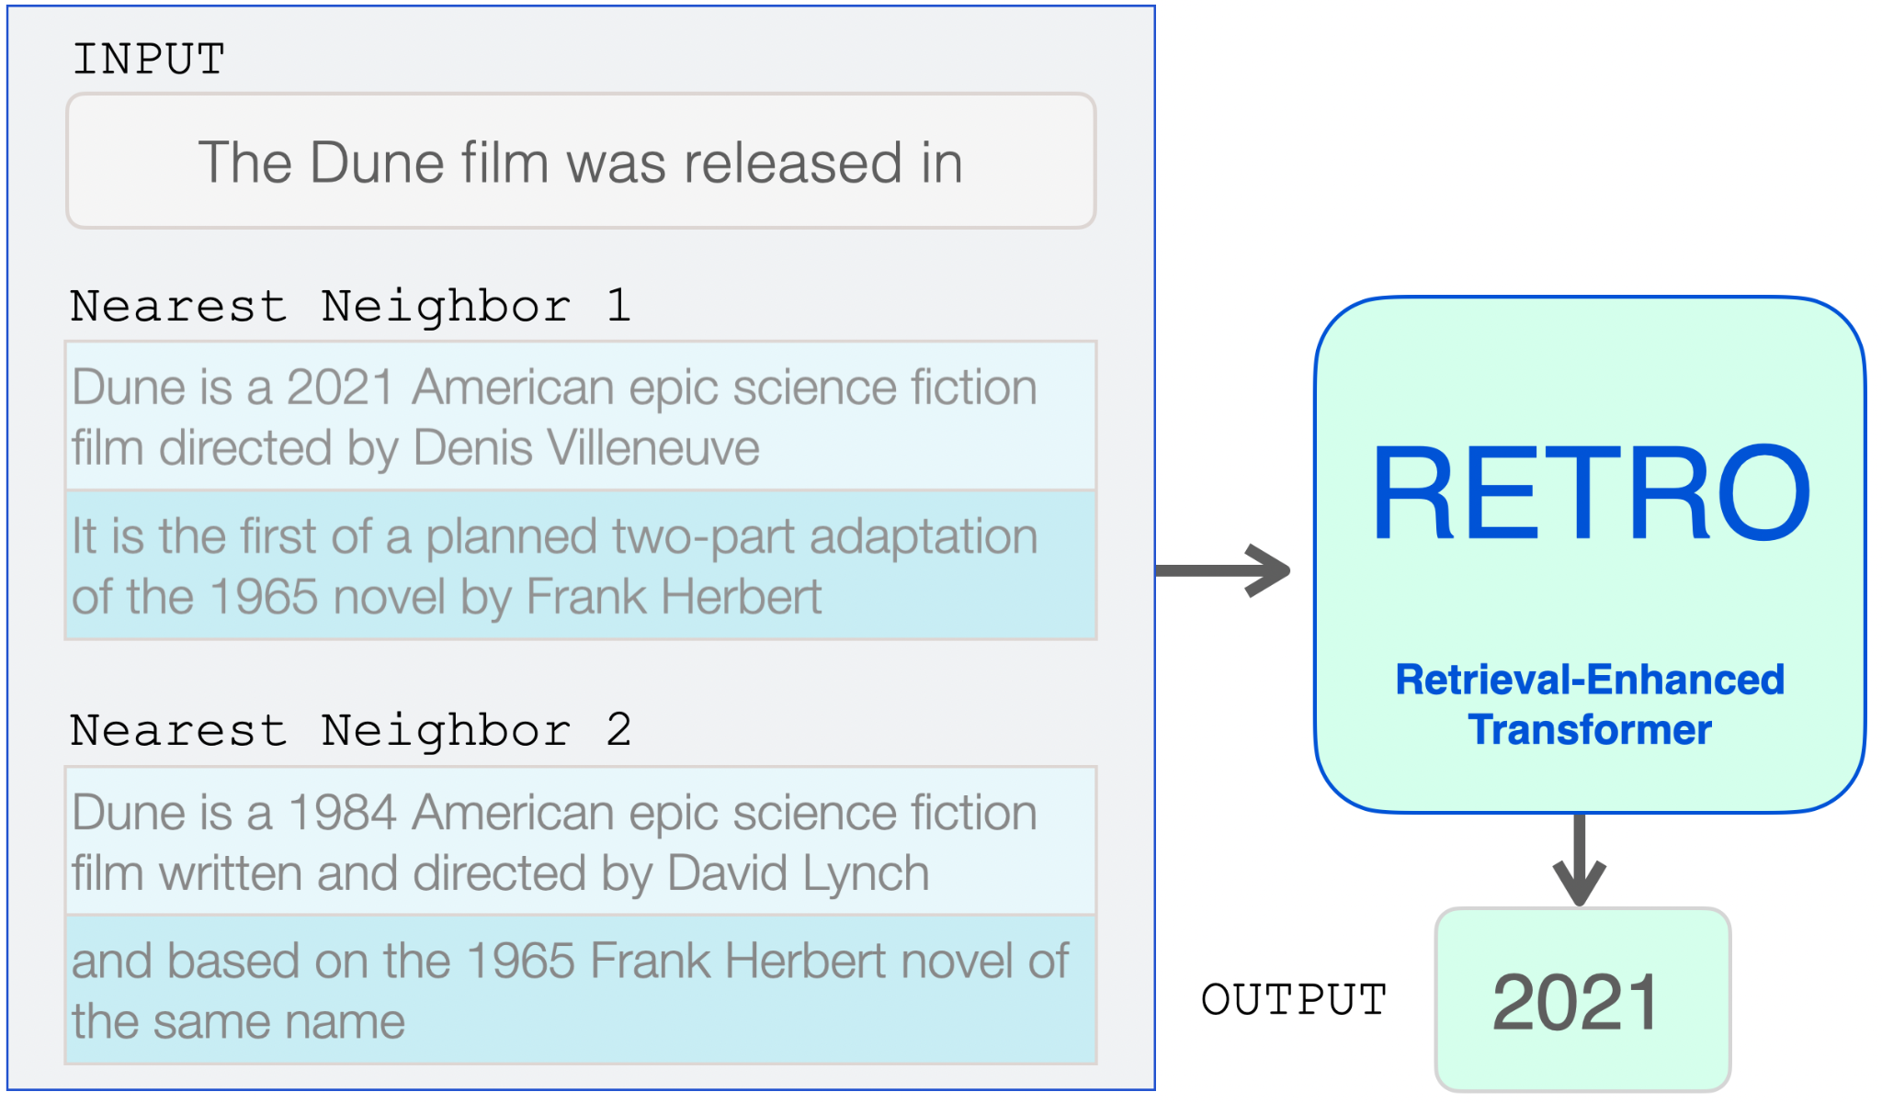
Method: Nearest Neighbor Retrieval
When storing key-value pairs in the database they use the structure:
Key: BERT embedding on N
Value: [N,F]
N: the neighbor chunk
F: its continuation in the original document
When retrieving a chunks k-nearest neighbors from the database they use the L₂ distance of the BERT embeddings
Notes:
Another method they use in their system is nearest neighbor retrieval
They use this retrieval technique when choosing which texts in the database to include in the set of data they encode for the transformer
The take the input sequence and determine the k-nearest neighbors
They store the data in key-value pairs based around N, or the neighbor chunk
Key: BERT embedding of the neighbor chunk
Value:
N, the neighbor chunk, also known as the contiguous chunk of tokens from the original document that is in some way related or similar to the chunk being processed
F, the continuation chunk, This continuation chunk allows the model to consider the context beyond the immediate neighbor chunk N, providing additional information that might be relevant for making predictions or enhancing understanding
The time complexity of this method are:
They: can query the approximate nearest neighbors in O(logn) times, n being the amount of elements in the database
However, they use the advantage of a frozen BERTmodel to precompute all the approximate nearest neighbors
Finally, when choosing the k-nearest neighbors they use the L_2 distance of the BERT embeddings

Slide 22
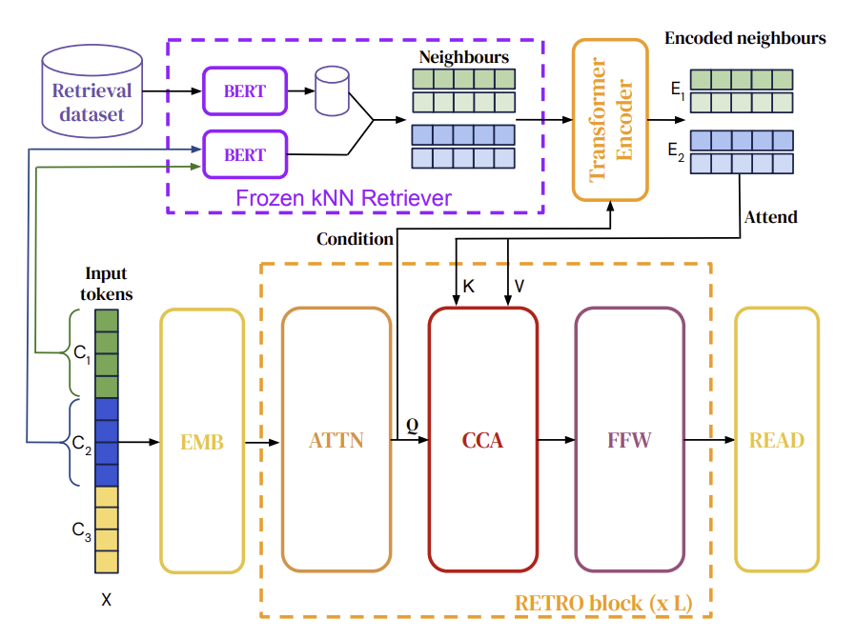
RETRO Model Architecture
Relies on an encoder-decoder transformer architecture
Integrates the retrieved data through a cross-attention mechanism
Notes:
A little deeper look into RETRO’s architecture:
The rely on an encoder-decoder transformer architecture
Steps
After the input sequence is used to get the set of k-nearest neighbors
Retrieved tokens are given to an transformer encoder
Computes an encoded neighbors set
They are then sent through the “RETRO”- block consisting of three layers
ATTN: sequence-level self-attention layer
CCA: cross-attention layer
FFW: a fully-connected layer
The output is then generated to be returned

Slide 23
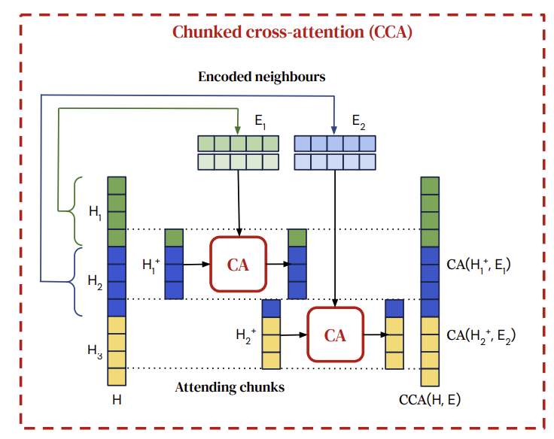
Chunked cross-attention
The layers goal is to perform attention operations across chunks of data in a sequence
Sequence of operations
Creation of chunked intermediate activation
Computing cross-attention
Concatenating and padding
Apply cross-attention residual operator
Notes:
A little deeper look into the chunked cross-attention layer since this is where the retrieved data is primarily integrated
The goal of the layer is perform attention operations on all the chunks of data
The whole process is a sequence of creation chunked intermediate activation, then computing cross-attention, concatenating and padding the results, and finally applying a cross-attention residual operator to get the output for the layer
Autoregressive Nature:
Chunked cross-attention is autoregressive, meaning that the output at a given position depends on the sequence of tokens up to that point.
Dependency Propagation:
Dependencies over previous neighbors are propagated via self-attention operations, enabling each token's activation to potentially depend on the set of all previous neighbors without incurring a quadratic cost.
Chunking intermediate activation
An intermediate activation matrix H is first split into l – 1 attending chunks denoted as H_u^+
Each H_u^+ holds embeddings of the last token in chunk C_u and the first m – 1 tokens in C_u+1
Cross-attention computation
Cross-arrention computations is computed between each H_u^+ and the encoded set obtained from chunk C_u
Attention is calculated across time and across neighbors simultaneously, utilizing relative positional encodings
Concatenation and padding
The outputs of the per-chunk cross-attentions are concatenated across time, forming the output activation CCA(H, E)
Cross-attention residual operator
The cross-attention residual operator is defined using parameter matrices K, Q, and V, and it operates on the intermediate embeddings and the encoded neighbors.
It involves applying softmax along the second dimension and performing matrix products.

Slide 24
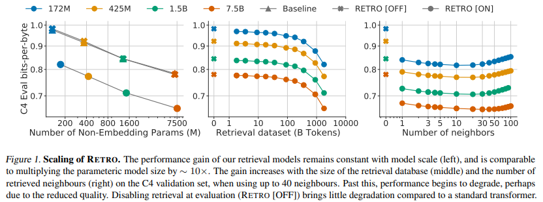
Results
Notes:
Results:
For the results, we’re mainly looking at the bits-per-byte (bpb) metric. This metric measures the average number of bits it takes to compute the next byte in a sequence. The lower the ratio is, the more computationally efficient
Here we have a few different graphs that help us evaluate the computational efficiency gains with RETRO. The underlying model is a basic transformer model.
On the left, we can see a large jump between the models with RETRO on and off. What we also see is a constant performance gain as we increase the model scale
In the middle, we can see how the retrieval dataset affects the computational efficiency of the model. Note how we don’t see that much of a performance increase from 1-10 billion tokens, but as we start reaching closer to the trillion mark, we start seeing a more significant increase in computational efficiency.
And on the right, we see consistent improvements for all models when the number of neighbours is increased from 1 to 10. Furthermore, we observe that larger models are able to better utilise more neighbours. It’s probably kinda hard to see, but the 7.5b parameter model is able to continue decreasing bpb up to 40 neighbors

Slide 25
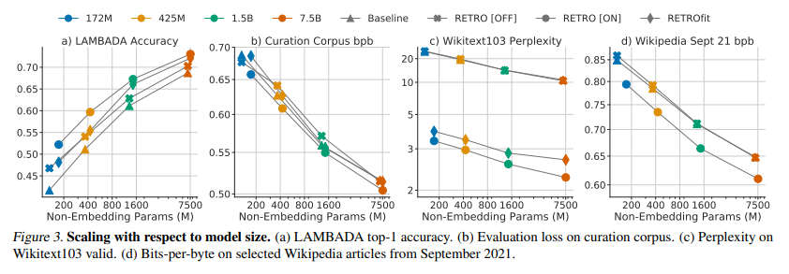
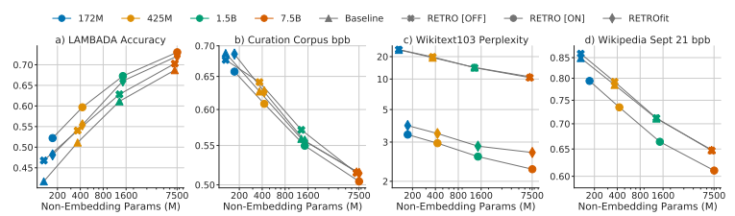
Results
Notes:
Results:
Here we’re looking at different performance metrics for different test sets. There’s lots of good information here, however I’d just like to focus just on graph B
This graph displays the bpb ratios as we increase the amount of parameters in the model, much like the previous graphs we looked at.
Note in this graph how there are very small gains with RETRO on. There’s a reason for this. This test, curation corpus, is to see if an LLM can create summaries of an article. The article is passed in, with the prompt asking to summarize, and then the output is compared against a human written summary. Because those summaries aren’t explicitly in our retrieval database, we see minimal gains by having RETRO turned on.
This is an example of a natural language understanding (or NLU) scenario, where the model is trying to understand the text and do something with that understanding. In our case, it’s trying to understand an article and summarize it. We should note that, in these NLU scenarios, the RETRO architecture brings about minimal gains, which we’ll see in the next slide

Slide 26
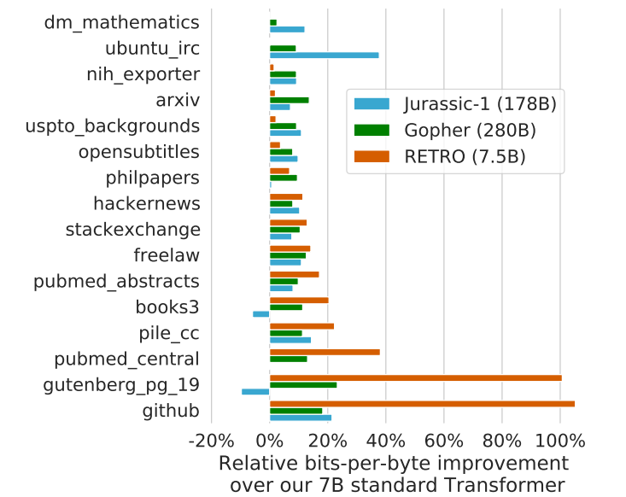

Results
Notes:
Results:
In these results, we’re looking at the bits-per-byte improvement over their standard 7B parameter transformer model.
We’re going to be looking at the relative improvement over a subset of the Pile test sets (the pile being a collection of datasets)
And we’re also going to compare the performance improvements of RETRO against two state of the art models (at least, at the time the paper was written) Jurassic-1 and Gopher.
We can see here that RETRO outperforms Jurassic-1 and Gopher on the majority of the Pile test sets, despite having only 7.5 billion parameters. Note how github, gutenberg_pg, and pubmed central all have quite large increases in relative bpb improvement
This is most likely because there’s a lot of domain knowledge surrounding these sets
Do note that on the dm_mathematics and ubuntu_irc subsets, RETRO doesn’t outperform the baseline. The authors hypothesized that the retrieval dataset doesn’t have useful data in it for these types of queries.

Slide 27
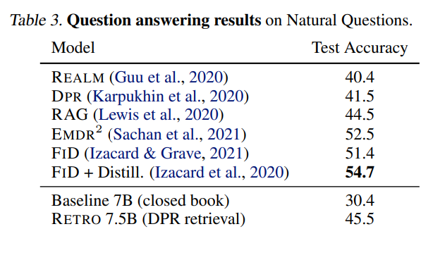
Results
Notes:
however good these improvements seem to be, it’s also worth comparing RETRO to other document retrieval models
Here we have a test for question answering accuracy, which is one of RETRO’s key strengths
Note how we have REALM here, and note how it performs worse than RETRO, but better than the baseline 7B parameter model.
This is showing how document retrieval, regardless of how it’s done, helps improve question answering task results
Also note how RETRO is outperformed by FID and EMDR^2 models. The authors hypothesize that the reason for this is that RETRO doesn’t place as much emphasis on retrieval encoder output, which is very important when it comes to question answering tasks

Slide 28
Future Work
Evaluate the performance of the RETRO model on NLU tasks
RETRO is very competitive when it comes to retrieval-intensive downstream tasks, like question answering; what about more NLU tasks besides CC?
Gain a broader understanding of the role of test set leakage in LM performance
Only a fraction of RETRO’s performance can be attributed to test set leakage, but what about in other LMs?
Consider new methods to force RETRO predictions to rely further on retrieval encoder output
RETRO lacks behind other retrieval models in question answering tasks
Notes:
With all of the results in mind, it’s worth considering what next steps are for RETRO
First, the authors suggest to evaluate the performance of RETRO on NLU tasks, like what we saw in the curation corpus test. It’s important to evaluate if broader groups of NLU tasks are affected at all by RETRO’s document retrieval system, whether positively or negatively.
The authors also suggest that we should evaluate how much other LMs, and particularly ones with document retrieval components, are affected by test set leakage. In the RETRO, the authors were able to quantify that RETRO only slightly benefits from test set leakage
And finally, the authors suggest to figure out ways to adapt RETRO such that it relies more on the documents retrieved in responding, and therefore is more competitive with other document retrieval type models.

Slide 29
Connections and Takeaways

Slide 30
Connections
Retrieval components are crucial to gain even more relevant external information during training or inference
Both use some sort of neighbor metric to fetch multiple related and relevant documents
Based on the additional information gain, both look to use fewer parameters in their base transformer models
Focused on factual tasks, like question answering, rather than NLU tasks
Notes:
Some connections between the two papers:
Retrieval components are very important when it comes to gaining relevant external information
Whether it’s the frozen BERT model RETRO uses, or the asynchronously updated BERT retriever in REALM
Both use some sort of neighbor metric to fetch multiple related documents
RETRO uses kNN, and REALM uses a MIPS algorithm to find the top k documents
In both papers, increased context via external related documents yields higher performance with less parameters
In both papers, we see large performance gains surrounding question and answering tasks, versus more understanding based tasks like text summarization

Slide 31
Takeaways
Increases in context via retrieval yields increased performance on question answering tasks
With increased performance because of more context, there is less of a need to increase parameter size → less GPU memory usage
Selecting the right retrieval and attention mechanisms for knowledge integration is important
Notes:
Some key insights and takeaways that we gain from the two papers are the following:
Increases in context yield increased performance on QA tasks
With increased performance comes less of a need for more and more parameters → less GPU memory needed
Making sure your retrieval mechanisms are tuned for speedy retrieval, and that the documents retrieved are integrated effectively in the response generation process (whether CCA or otherwise) are both important in creating the most effective and efficient document retrieval model

Slide 32
Thank you!
Q&A time

